Slide 1
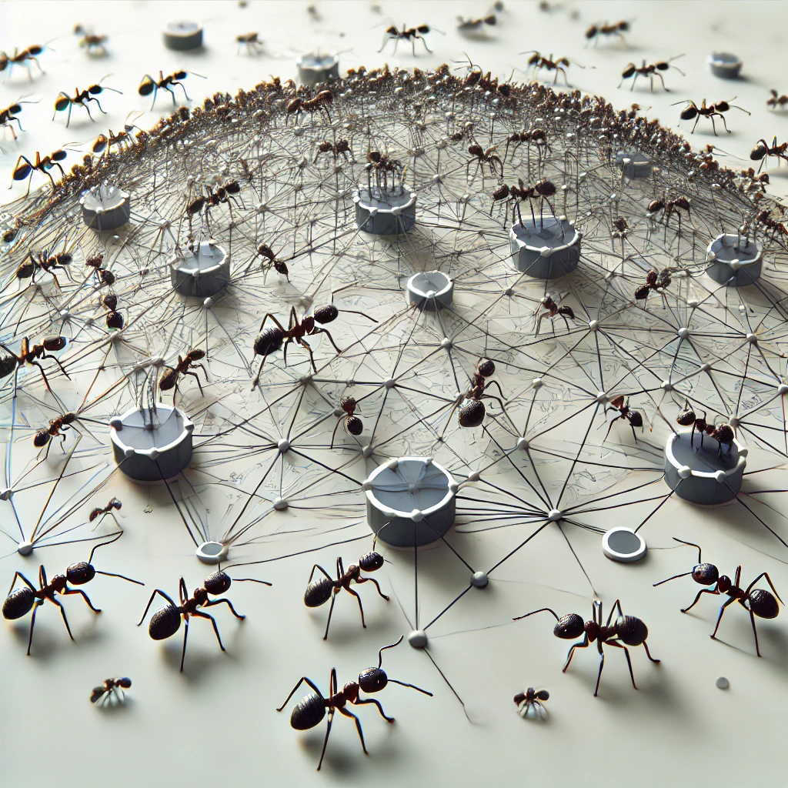

Citation Prediction using Ant Colony based Multi-Level Network Embedding
Capstone Project Phase A 24-2-D-19
Yoni Azeraf - 209459239
Itamar Kraus - 318304763
Supervisor:
Dvora Toledano Kitai

Slide 2
Motivation
Academic papers are crucial for knowledge dissemination and research advancement.
A common issue in academic writing involves including citations that are weak or irrelevant.
These citations do not contribute meaningfully to the content or purpose of the paper.
The use of such citations negatively affects the quality and relevance of academic papers.

Slide 3

Current State and Project Need
Existing approaches to tackle this problem, such as manual screening and expert reviews do exist, but these methods suffer from subjectivity and inadequate accuracy.
Therefore, there is an increasing need for a more objective, scalable, and precise automated solution to assess the relevance of citations.

Slide 4
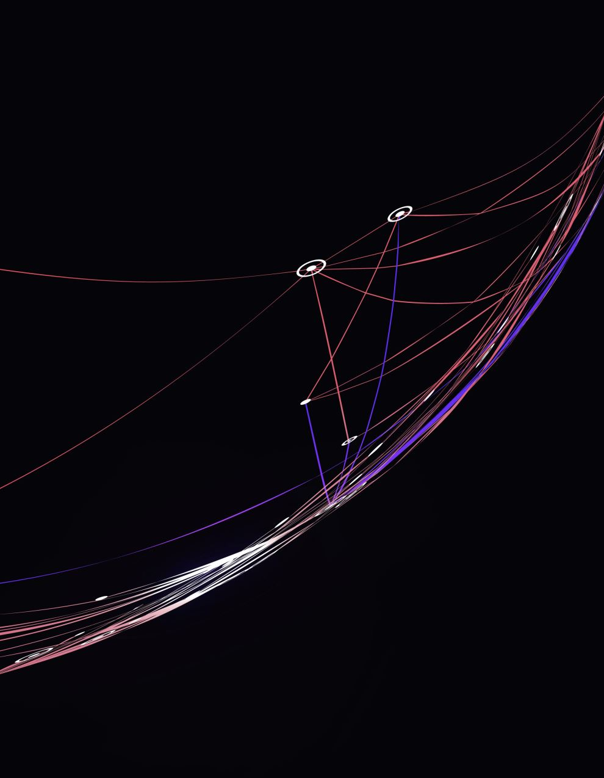
Embedding Approaches
There are different types of embedding approaches that try to represent nodes using lower dimensional embedding vectors, allowing the graph to be mapped to an embedding vector space.
Those approaches struggle to scale up for handling large-scale graphs or fail to reflect the global hierarchical clustering properties.
Few advanced embedding algorithms aim to deal with these problems using Graph Clustering Pyramid like HARP, NetLay and ACE.

Slide 5
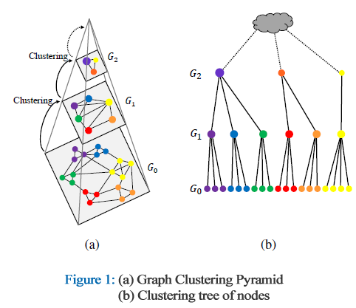
Graph Clustering Pyramid
To capture the global hierarchical clustering property, a graph is modeled by a Graph Clustering Pyramid.
The fundamental process in building a Graph Clustering Pyramid involves clustering closely related nodes and merging them into coarser graphs in the upper layers.
In this model, clustering the nodes simplifies the graph into multiple layers.

Slide 6
Implementation Tools
ACE approach utilize an Ant Colony Optimization (ACO) to construct a multi-level network embedding while capturing the coarsened graphs’ properties at each layer.
ACE can be used with any basic embedding algorithm in its process and in our research plan, node2vec.
Graph based on the CORA dataset.

Slide 7
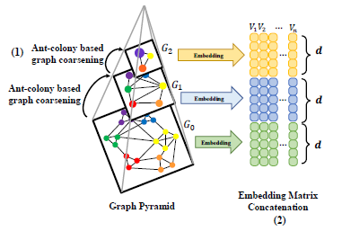
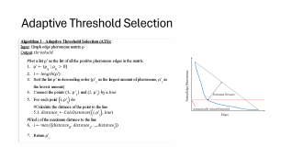
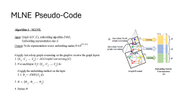
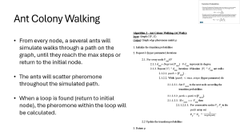
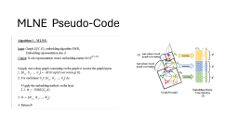
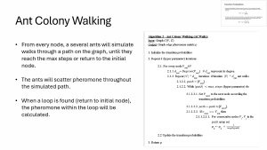
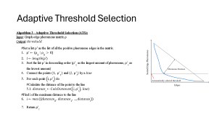
Multi Level Network Embedding (MLNE)
ACGraphCoarsening (Algorithm - 4)
Embedding for each layer - node2vec
Embedding Matrix
Graph Layers
Embedding concatenation
Zoom in
Algorithm - 2
Algorithm - 3

Slide 8

Node2vec Embedding
Node2Vec is an efficient algorithm designed for learning continuous feature representations of nodes within graphs.
It employs random walks to explore network neighborhoods effectively, balancing between local and global structures.
The algorithm optimizes a neighborhood preserving objective function using a Skip-Gram model.

Slide 9
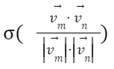
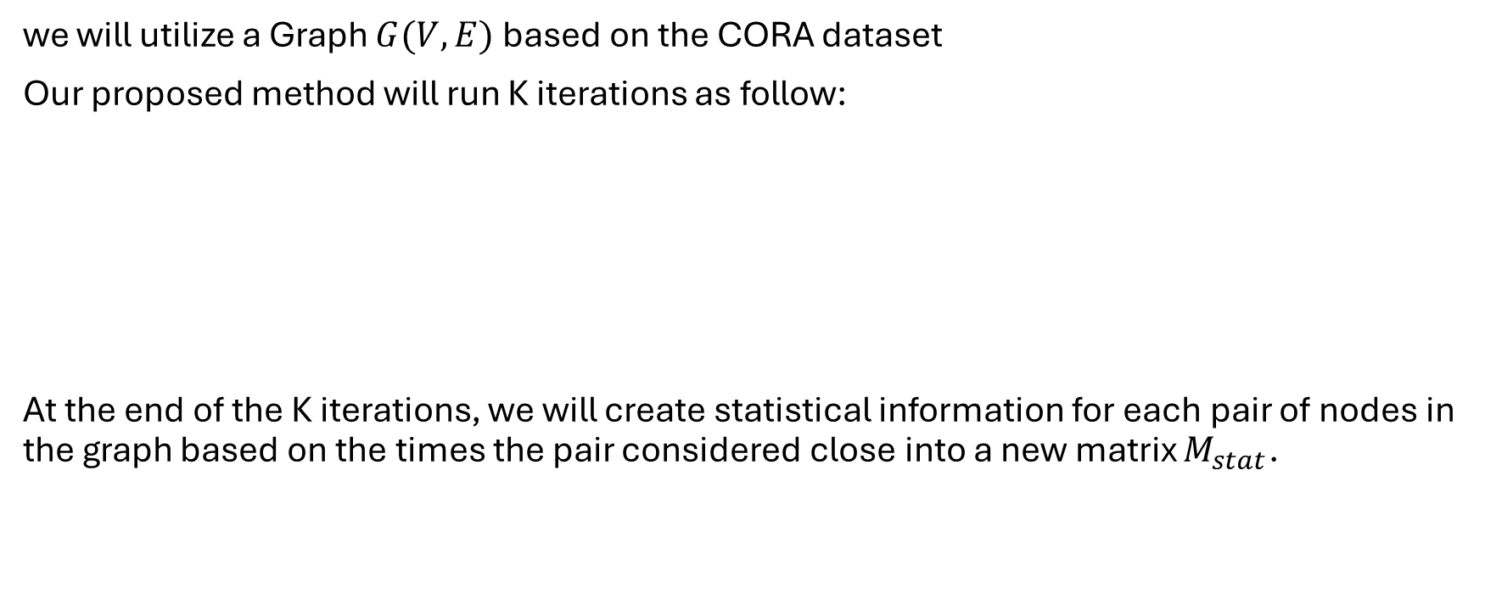
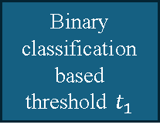
Proposed Research Plan
we will utilize a Graph $G(V,E)$based on the CORA dataset
Our proposed method will run K iterations as follow:
At the end of the K iterations, we will create statistical information for each pair of nodes in the graph based on the times the pair considered close into a new matrix $M_{stat}$.
Randomly remove a predetermined percentage of edges
Algorithm 1 MLNE
Calculate the normalized cosine similarity
Binary classification based threshold $t_{1}$
CORA Graph

Slide 10
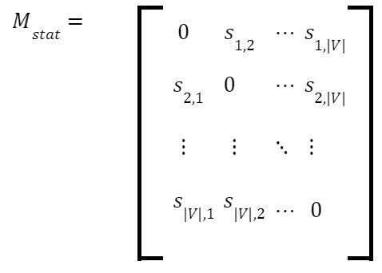
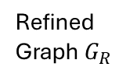
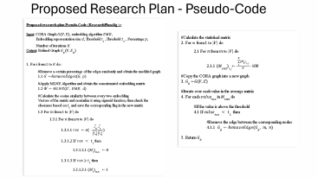
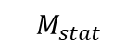
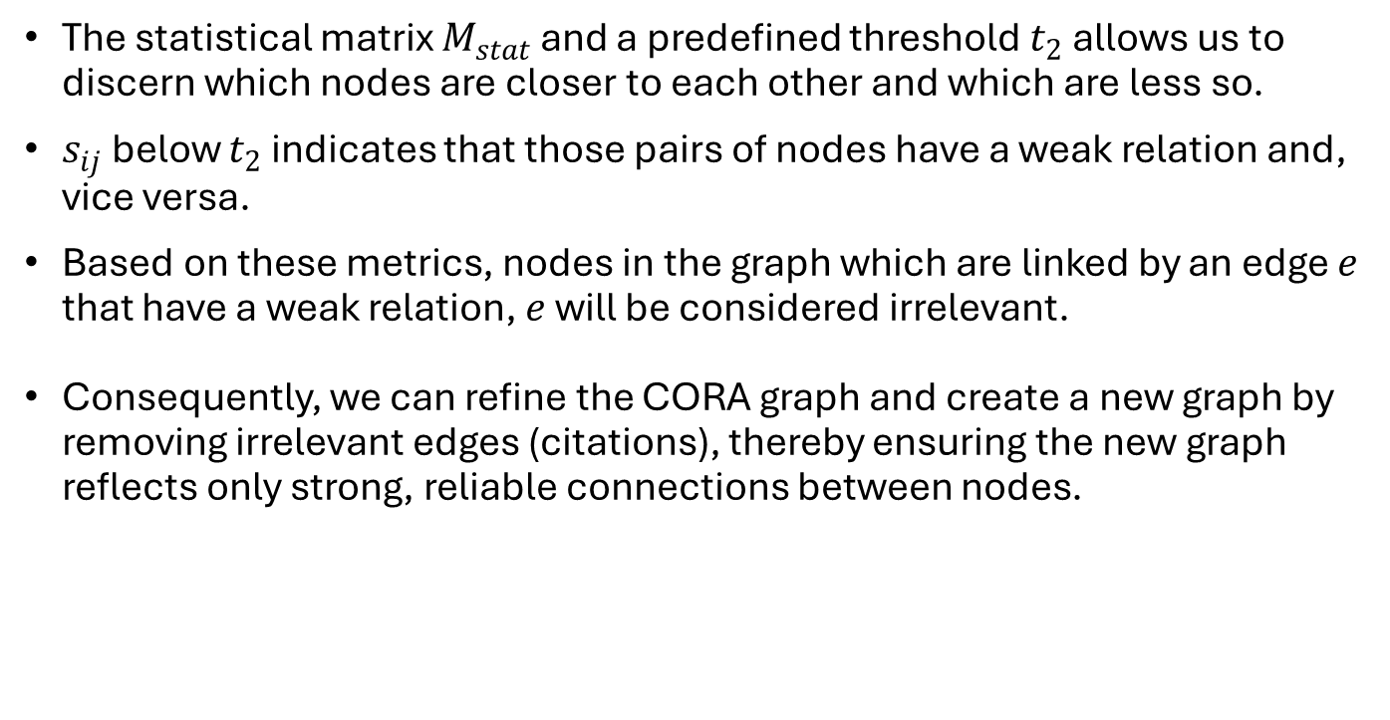
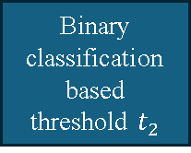
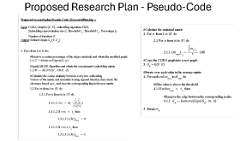
Proposed Research Plan
Calculate statistical information
Binary classification based threshold $t_{2}$
Remove Edges
Refined Graph$G_{R}$
$$M_{stat}$$
Edges to remove
The statistical matrix $M_{stat}$ and a predefined threshold $t_{2}$ allows us to discern which nodes are closer to each other and which are less so.
$s_{ij}$ below $t_{2}$ indicates that those pairs of nodes have a weak relation and, vice versa.
Based on these metrics, nodes in the graph which are linked by an edge $e$ that have a weak relation, $e$ will be considered irrelevant.
Consequently, we can refine the CORA graph and create a new graph by removing irrelevant edges (citations), thereby ensuring the new graph reflects only strong, reliable connections between nodes.

Slide 11
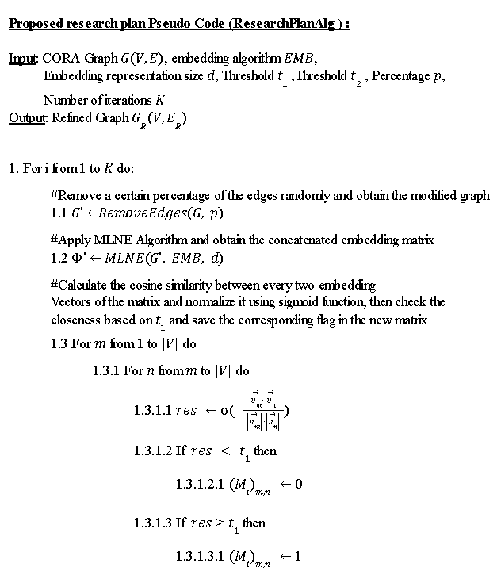
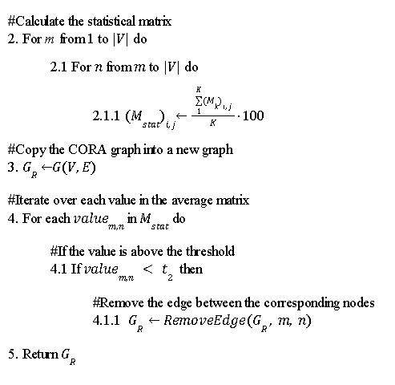
Proposed Research Plan - Pseudo-Code

Slide 12
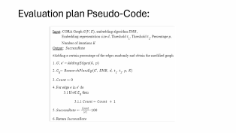

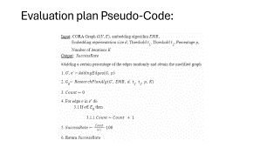
Evaluation plan
In order to validate the model, we propose a similar process on artificial graphs that come across from the original citation graph by randomly adding edges and comparing the results of the model to the original graph.
To accurately assess the success of the proposed model, we will execute the evaluation plan multiple times and then average the results.
Randomly adding edges
$$ResearchPlanAlg$$
Calculate the success rate

Slide 13
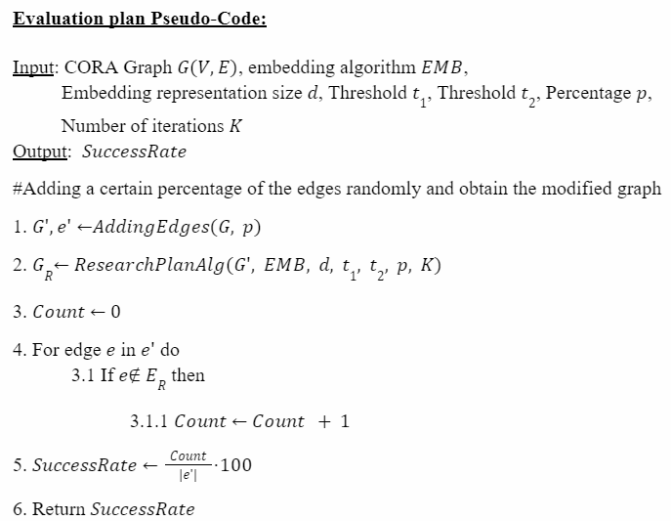
Evaluation plan Pseudo-Code:

Slide 14

Expected Achievements
Our project’s main goal is utilizing an Ant Colony based Multi-level Network Embedding (ACE ) to identify irrelevant citations in scholarly articles by capturing the clustering properties of graphs at multiple levels.
By creating a citation graph from the CORA dataset and implementing the ACE algorithm, we aim to identify and evaluate citation relevance.
Our expected achievement for this project is to expose at least 85% of the irrelevant citations within the citation graph.

Slide 15

The upcoming challenges
Dataset issues:
Finding suitable academic articles with citation information can be challenging.
Ensuring a comprehensive ,diverse and representative of different academic fields.
Scalability and efficiency:
Dealing with the computational complexity of the algorithm for large scale datasets.
Limited on hardware resources for training and perfecting the model.
Lack of experience:
Limited expertise in Graph analysis and Node classification poses a challenge due to the unfamiliarity with the field, potentially impacting the project's progress and outcomes.

Slide 16
Thank you for listening !

Slide 17
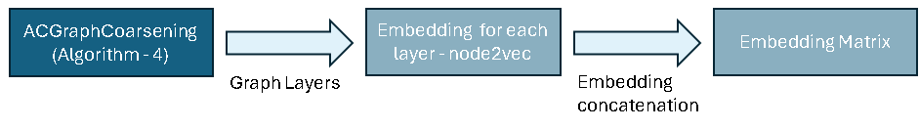
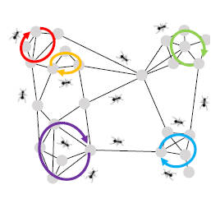
Ant Colony Based Graph Coarsening
The main challenge lies in determining the relationship between nodes in a graph. In an undirected graph, the local context of two nodes can be described by a set of closed loops.
A higher number of loops that include both nodes suggests a stronger relationship. Similarly, smaller loops indicate a closer relationship between the nodes.
To identify the close connections defined by loops, it is suggested to use an ant colony optimization (ACO) based Ant Colony Walking algorithm.

Slide 18
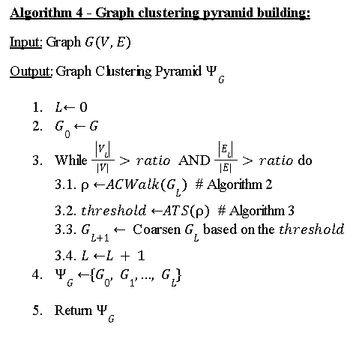
Graph clustering pyramid building
The algorithm shows the building process of the clustering pyramid.
There is a ratio (hyper parameter) that determines when the algorithm stops to create more graph layers, it’s a relation between the number of nodes and edges in the last coarsened graph (L) to the number of nodes and edges in the original graph.

Slide 19
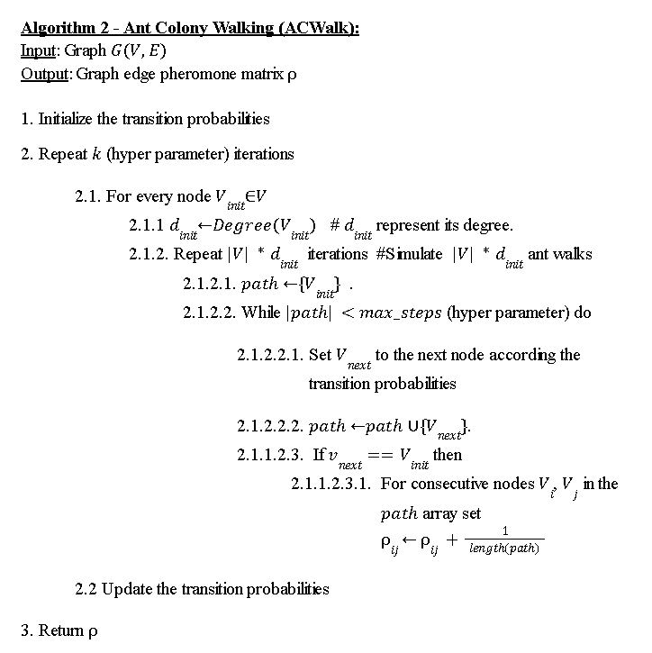
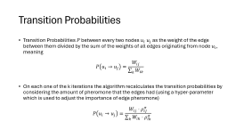
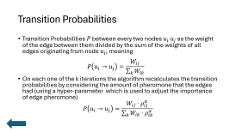
Ant Colony Walking
From every node, a several ants will simulate walks through a path on the graph, until they reach the max steps or return to the initial node.
The ants will scatter pheromone throughout the simulated path.
When a loop is found (return to initial node), the pheromone within the loop will be calculated.

Slide 20
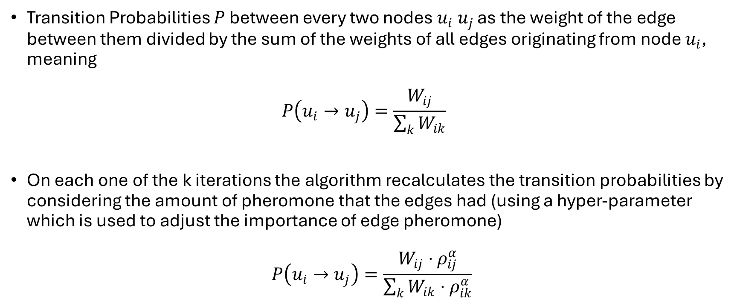
Transition Probabilities
Transition Probabilities $P$ between every two nodes $u_{i} u_{j}$ as the weight of the edge between them divided by the sum of the weights of all edges originating from node $u_{i}$, meaning $P\left(u_{i}→u_{j}\right)=\frac{W_{ij}}{\sum_{k}{W_{ik}}}$
On each one of the k iterations the algorithm recalculates the transition probabilities by considering the amount of pheromone that the edges had (using a hyper-parameter which is used to adjust the importance of edge pheromone)
$$P\left(u_{i}→u_{j}\right)=\frac{W_{ij}⋅ρ_{ij}^{α}}{\sum_{k}{W_{ik}⋅ρ_{ik}^{α}}}$$

Slide 21
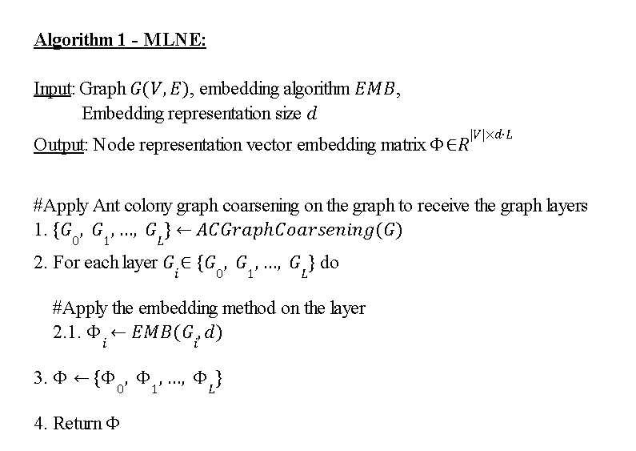
MLNE Pseudo-Code

Slide 22
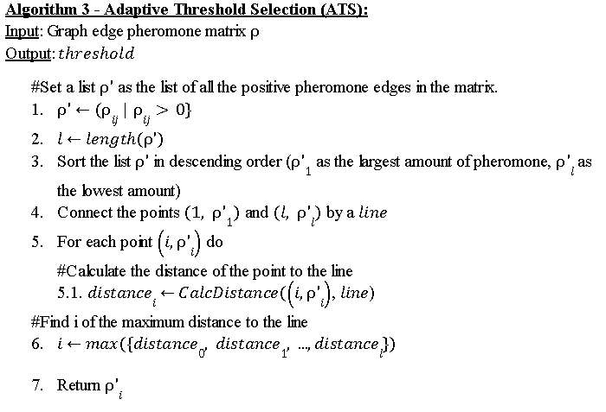
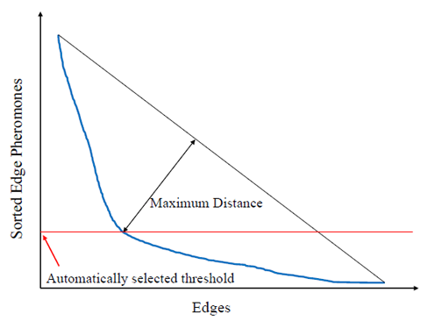
Adaptive Threshold Selection

